Slide 1

Consumer Behavior: Buying, Having, and Being
Twelfth Edition
Chapter 12
Income and Social Class
Copyright © 2017, 2015, 2013 Pearson Education, Inc. All Rights Reserved.
Notes:
If this PowerPoint presentation contains mathematical equations, you may need to check that your computer has the following installed:
1) MathType Plugin
2) Math Player (free versions available)
3) NVDA Reader (free versions available)
This chapter defines the scope of international business and introduces us to some of its most important topics.

Slide 2
Learning Objectives
12.1 Our confidence in our future, as well as in the overall economy, determines how freely we spend and the types of products we buy.
12.2 We group consumers into social classes that say a lot about where they stand in society.
12.3 Individuals’ desire to make a statement about their social class, or the class to which they hope to belong, influences the products they like and dislike.
Notes:
We’ll cover several objectives in the chapter. These are listed in slides 2-4.

Slide 3

Learning Objective 12.1
Our confidence in our future, as well as in the overall economy, determines how freely we spend and the types of products we buy.
Notes:
This chapter begins by considering how people appear based on the products we surround ourselves with. Phil, pictured, is meeting his girlfriend’s parents. He’s surprised to find that even though Marilyn hinted the family had money that the family had very plain surroundings.

Slide 4
To Spend or Not To Spend
Discretionary income is the money available to a household over and above what it requires to have a comfortable standard of living.
How we spend varies, based in part on our attitudes toward money.
Tightwads
Spendthrifts
Notes:
Tightwads hate to part with their money and actually experience emotional pain when they make purchases. Spendthrifts enjoy nothing more than spending. Frugality seems to be driven by a pleasure of saving, compared to tightwaddism which is driving by a pain of paying. Consumer research on attitudes toward money found eight segments. These ranged from crash dieters who would try to cut out all nonessential spending until things improved to vultures who circle the market looking for bargains.

Slide 5
Consumer Confidence
Factors affecting savings rate:
Pessimism/optimism
World events
Cultural differences in attitudes toward savings
Notes:
Behavioral economics is also called economic psychology. It is the study of the human side of economic decisions. Consumers’ beliefs about what the future holds are an indicator of consumer confidence. Consumer confidence is a measure of how optimistic or pessimistic people are about the future health of the economy and how they predict they’ll fare down the road. When people are optimistic about the future, they tend to reduce their savings rate. In addition, world events and culture affect overall savings rates. The person depicted in the Bianco ad is tired of hearing about the financial crisis.

Slide 6
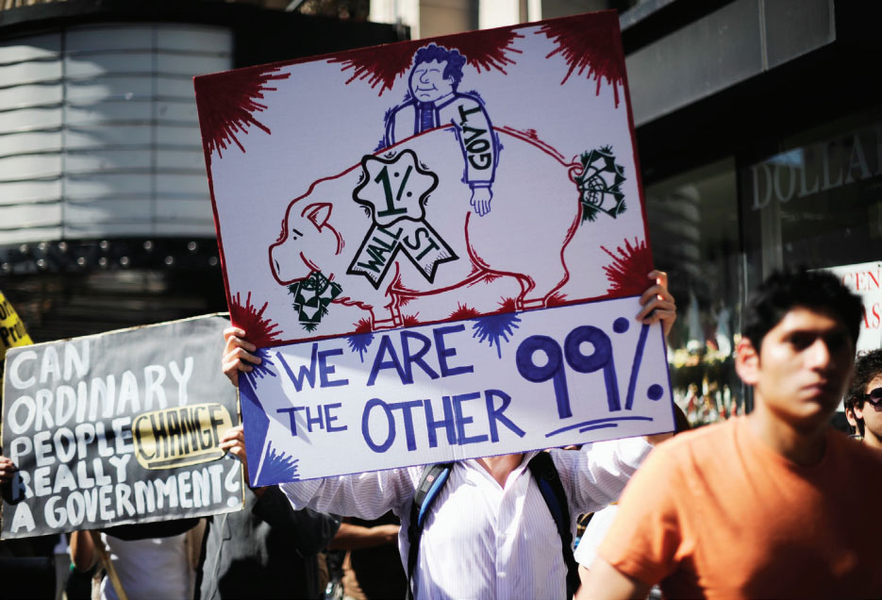
Income Inequality
Plutonomy
Notes:
Plutonomy to describe an economy that’s driven by a fairly small number of rich people.

Slide 7
Social Mobility
Horizontal Mobility
Upward Mobility
Downward Mobility
Notes:
Social mobility refers to the passage of individuals from one social class to another. Horizontal mobility occurs when a person moves from one position to another that is roughly equal. For instance, when a nurse becomes an elementary school teacher, horizontal mobility has occurred. Upward mobility means moving to a higher status. Downward movement is losing social status. Overall though most people remain in their social class. The improvements people make are not sufficient to shift them into a whole other class. The exception is when someone marries someone who is much richer.

Slide 8
Income Based Marketing
Two factors contribute to an (overall) upward income trajectory:
A shift in women’s roles
Increases in educational attainment

Slide 9

Consumer View of Luxury Goods
Luxury is functional
Luxury is a reward
Luxury is indulgence
Notes:
SBI divides consumers into three groups based on their attitudes toward luxury. Consumers who use their money to buy things that will last and have enduring value view luxury as functional. Those who use luxury goods to say “I’ve made it” view luxury as a reward. Those who seek out luxury goods in order to illustrate their individuality take an emotional approach to luxury spending and view luxury as indulgence.

Slide 10
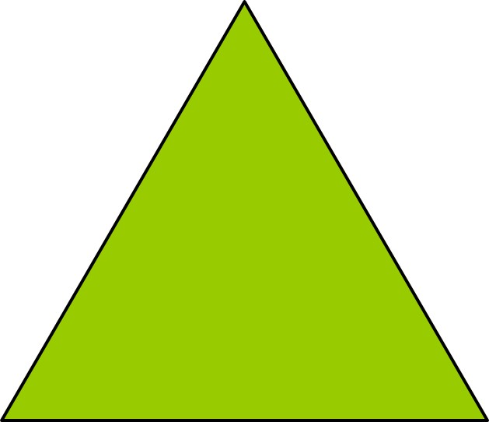
The Income Pyramid
Top of the Pyramid
Bottom of the Pyramid
Notes:
We typically assume that marketers are targeting consumers at the top of the pyramid. Those are consumers with the highest incomes but they are also a small percentage of the world market. There are also marketers targeting the bottom of the pyramid. 78% of the global population is low income consumers whose purchasing power is under $10,000 per year.

Slide 11
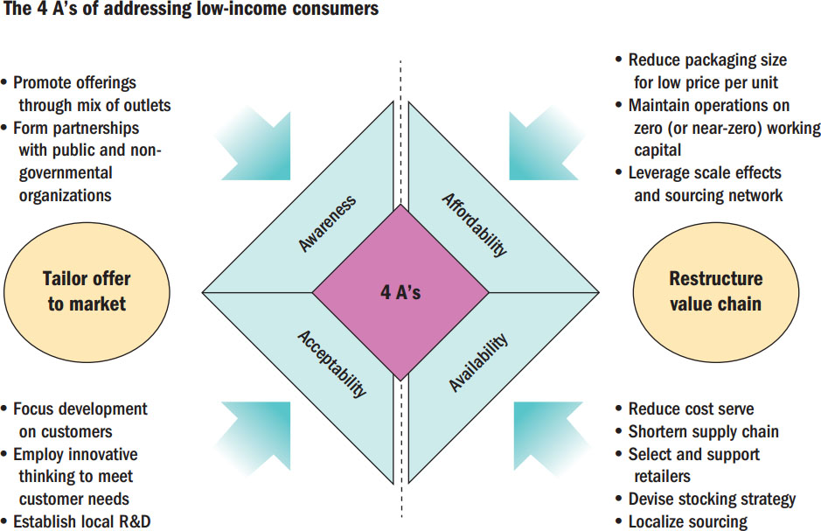
Figure 12.1 The 4 As
Source: Anderson and Niels Billou, “Serving the World’s Poor: Innovation at the Base of the Economic Pyramid,” Journal of Business Strategy 28, 2: 14–21, reprinted in A. T. Kearney, Serving the Low-Income Consumer: How to Tackle This Mostly Ignored Market, 2011, atkearney com
Notes:
This figure illustrates how marketers can market to low-income consumers. The As include awareness, affordability, availability, and acceptability.

Slide 12
For Reflection (1 of 3)
How does your own attitude toward spending affect your general shopping patterns?
Notes:
You may wish to consider the types of spending and saving categories shown in the Marketing Opportunity box in this segment. Is your own spending reflected in one of the types?

Slide 13
Learning Objective 12.2
We group consumers into social classes that say a lot about where they stand in society.
Notes:
Our second learning objective focuses on social class and how consumer behavior relates to social class.

Slide 14
Social Class Structure
“Haves” versus “have-nots”
Social class is determined by income, family background, and occupation
Universal pecking order: relative standing in society
Social class affects access to resources
Notes:
We use the term social class to describe the overall rank of people in a society. People who belong to the same social class have approximately equal social standing in the community. They work in similar occupations and tend to have similar lifestyles. We tend to marry people in a similar social class to ours, a tendency that sociologists call homogamy.

Slide 15
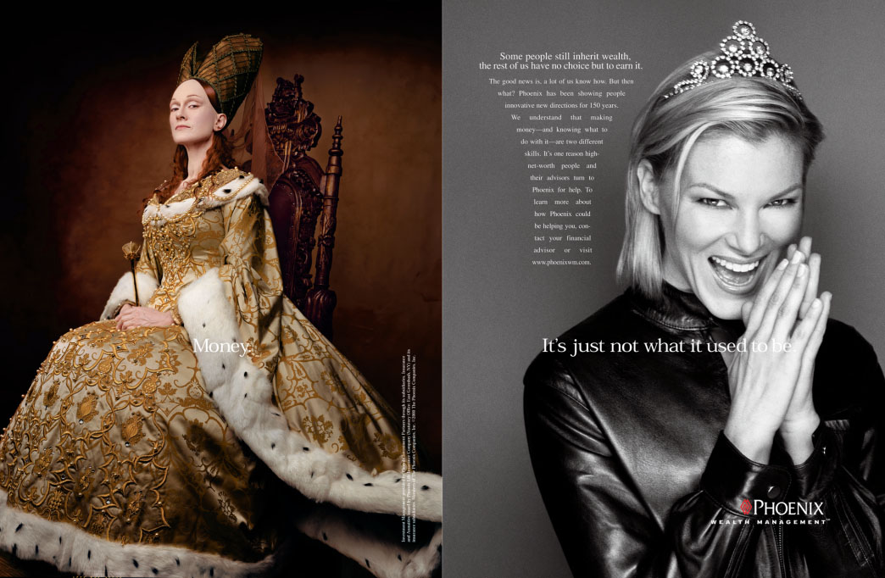
Picking a Pecking Order
Artificial divisions in a society
Achieved versus ascribed status
Status hierarchy
Notes:
Social stratification refers to the creation of artificial divisions among people such that some members get more resources than others by virtue of their relative standing, power, or control in the group. In groups, some resources are earned through hard work and this is known as achieved status. Others may get resources because of who they are and this is known as ascribed status. Most groups do exhibit a status hierarchy where some members are better off than others.

Slide 16
Components of Social Class
Occupational prestige
Is stable over time and similar across cultures
Single best indicator of social class
Income
Wealth not distributed evenly across classes (top fifth controls 75% of all assets)
How money is spent is more influential on class than income
Notes:
Social class includes multiple determining factors but two highly influential factors are occupational prestige and income. Occupation is considered the best indicator of social class because it is strongly linked to use of leisure time, allocation of family resources, aesthetic preferences, and political orientation. The distribution of wealth determines which groups have the greatest buying power and market potential.

Slide 17

Social Stratification
Status hierarchy
Occupational prestige
Worldview
Affluenza
Cosmo-politanism
Notes:
The process of social stratification refers to this creation of artificial divisions, “those processes in a social system by which scarce and valuable resources are distributed unequally to status positions that become more or less permanently ranked in terms of the share of valuable resources each receives.”
Most groups exhibit a structure, or status hierarchy in which some members are better off than others. They may have more authority or power, or other members simply like or respect them.
In a system in which (like it or not) we define people to a great extent by what they do for a living, occupational prestige is one way we evaluate their “worth.”
A worldview is another way to differentiate among social classes. To generalize, the world of the working class (i.e., the lower-middle class) is more intimate and constricted.
For example, working-class men are likely to name local sports figures as heroes and are less likely to take long vacation trips to out-of-the-way places.
Many well-off consumers seem to be stressed or unhappy despite or even because of their wealth, a condition some call affluenza.
Cosmopolitanism is an aspect of worldview that is starting to receive more attention by consumer behavior researchers, who define a cosmopolitan as someone who tries
to be open to the world and who strives for diverse experiences (not to be confused with the popular cocktail).

Slide 18
Predicting Consumer Behavior
Social class is better predictor of lower to moderately priced symbolic purchases
Income is better predictor of major nonstatus/nonsymbolic expenditures
Need both social class and income to predict expensive, symbolic products
Notes:
Social class and income can be useful in predicting consumer choices, but not always.

Slide 19
Problems with Social Class Segmentation
Ignores status inconsistencies
Ignores intergenerational mobility
Ignores subjective social class
Ignores consumers’ aspirations to change class standing
Ignores the social status of working wives
Notes:
Social class remains an important way to categorize consumers. However, marketers fail to use social class information as effectively as they could because of the reasons above.

Slide 20
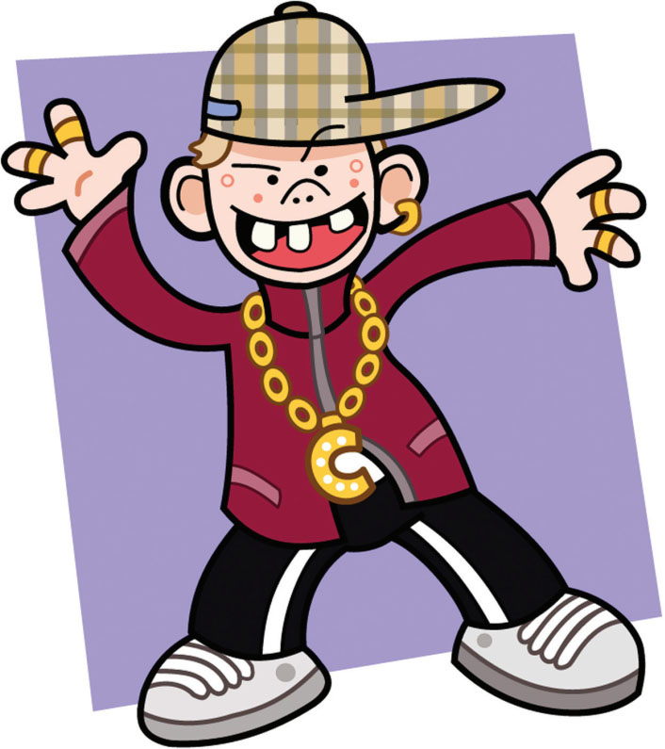
Social Class around the World
China
Japan
The Middle East
The United Kingdom
India

Slide 21
For Reflection (2 of 3)
How do you assign people to social classes, or do you at all?
What consumption cues do you use (e.g., clothing, speech, cars, etc.) to determine social standing?

Slide 22
Learning Objective 12.3
Individuals’ desire to make a statement about their social class, or the class to which they hope to belong, influences the products they like and dislike.
Notes:
It’s becoming more difficult to identify social class from product choices. Think about how many college women you know who have a Coach purse but eat ramen noodles for dinner.

Slide 23
Taste Cultures
Taste culture differentiates people in terms of their aesthetic and intellectual preferences
Upper- and upper-middle-class are more likely to visit museums and attend live theater
Middle-class is more likely to go camping and fishing
Notes:
A taste culture describes consumers in terms of their aesthetic and intellectual preferences. This concept helps us to understand subtle distinctions in consumer choices.
Another approach to social class focuses on codes, the ways consumers express and interpret meanings. Restricted codes focus on the content of objects, rather than on the relationships among objects. Elaborated codes are more complex. Table 12.1 in the text summarizes these differences.

Slide 24
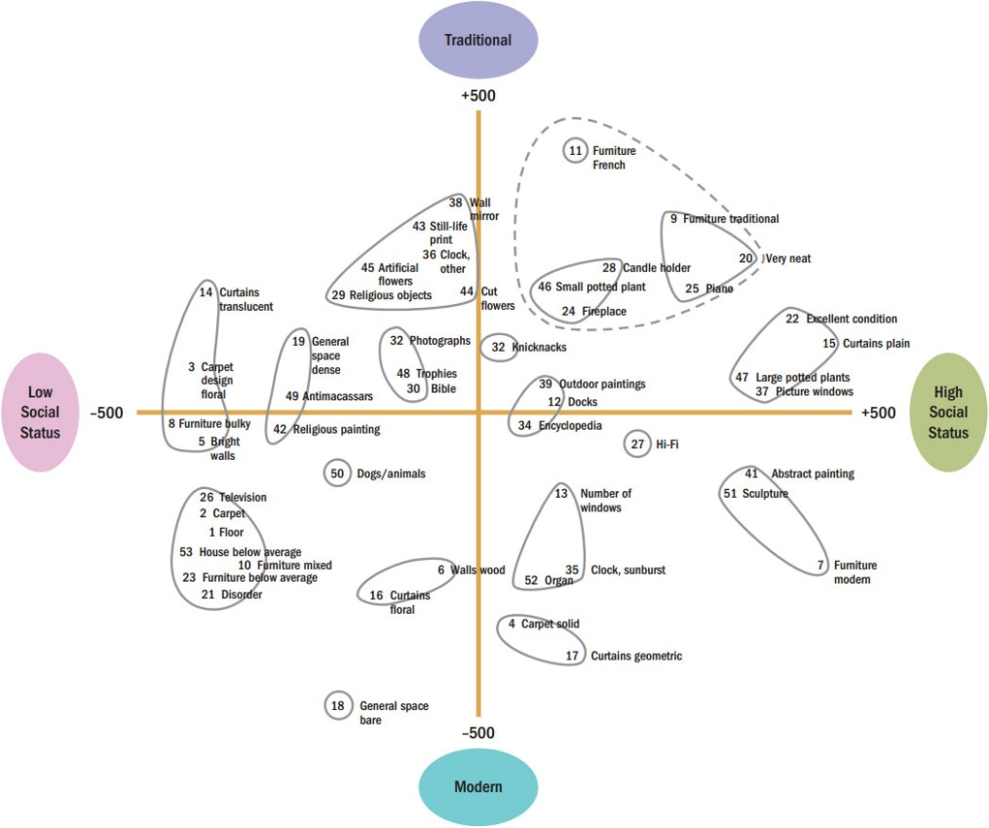
Figure 12.2 Living Room Clusters and Social Class
Source: Adapted from Edward O. Laumann and James S. House, “Living Room Styles and Social Attributes: The Patterning of Marerial Artifacts in a Model Urban Community,” Sociology and Social Research 54 (April 1970): 321–342. Copyright, University of Southern California, April 1970. All rights reserved.
Notes:
In one study of social differences in taste, researchers catalogued home owners’ possessions as they sat in their living rooms and asked them about their income and occupation. They identified clusters of furnishings and decorative items that seemed to appear together with some regularity. They found different clusters based upon social status as shown in the figure.

Slide 25
Restricted Codes versus Elaborated Codes
Table 12.1 Effects of Restricted versus Elaborated Codes
blank | Restricted Codes | Elaborated Codes
General characteristics | Emphasize description and contents of objects Have implicit meanings (context dependent) | Emphasize analysis and interrelationship between objects; i.e., hierarchical organization and instrumental connections Have explicit meanings
Language | Use few qualifiers, i.e., few adjectives or adverbs Use concrete, descriptive, tangible symbolism | Use large vocabulary, complex conceptual hierarchy
Social relationships | Stress attributes of individuals over formal roles | Stress formal role structure, instrumental relationships
Time | Focus on present; have only general notion of future | Focus an instrumental relationship between present activities and future rewards
Physical space | Locate rooms, spaces in context of other rooms and places: e.g., “front room,” “corner store” | Identify rooms, spaces in terms of usage; formal ordering of spaces; e.g., “dining room,” “financial district”
Implications for marketers | Stress inherent product quality, contents (or trust-worthiness, goodness of “real-type”), spokesperson Stress implicit of fit of product with total lifestyle Use simple adjectives, descriptions | Stress differences, advantages vis-à-vis other products in terms of some autonomous evaluation criteria Stress product’s instrumental ties to distant benefits Use complex adjectives, descriptors
Source: Adapted from Jeffrey F. Durgee, “How Consumer Sub-Cultures Code Reality: A Look at Some Code Types,” in Richard J. Lutz, ed., Advances in Consumer Research 13 (Provo, UT: Association of Consumer Research, 1986): 332

Slide 26
Social and Cultural Capital
Social capital
Cultural capital
Glamping
Online social capital
Reputation economy
Online gated community
Notes:
The transformation of Burning Man from what used to be known as a countercultural celebration to a showcase for wealth illustrates Bourdieu’s concept of social capital.
Cultural capital refers to a set of distinctive and socially rare tastes and practices—knowledge of “refined” behavior that admits a person into the realm of the upper class.
Glamping is glamorous camping.
The “psychic income” we get when we post reviews that others validate creates a reputation economy, in which the “currency” people earn is approval rather than cold hard cash.
And, like exclusive country clubs, online gated communities that selectively allow access to some people may offer a high degree of social capital to the lucky few who pass the test.

Slide 27
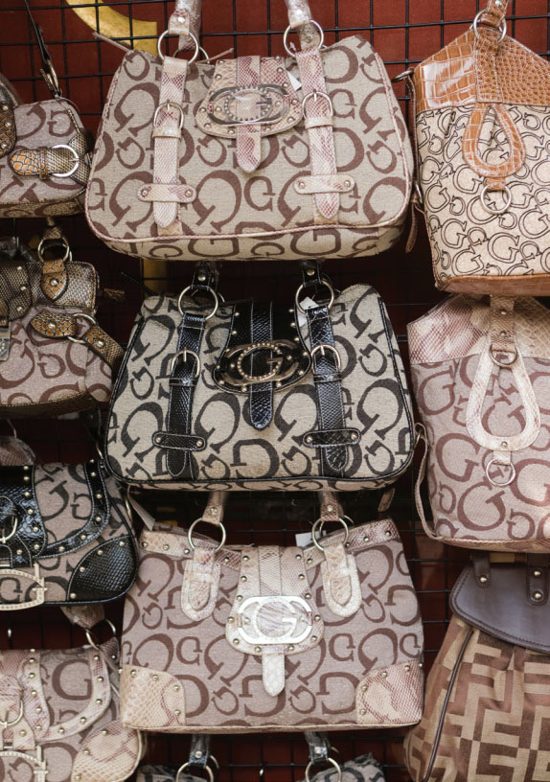
Status Symbols
Invidious consumption
Conspicious consumption
Leisure class
Trophy wives
Cougars
Brand prominence
Status signaling
Notes:
For Veblen, we buy things to create invidious distinction this means that we use them to inspire envy in others through our display of wealth or power. Veblen coined the term conspicuous consumption to refer to people’s desires to provide prominent visible evidence of their ability to afford luxury goods.
Although status seeking through product consumption and display is a worldwide phenomenon, some find the best tactic is to do the opposite. In that case, status is attained by avoiding it. Social scientists call this form of conspicuous consumption parody display.
This phenomenon of conspicuous consumption was, for Veblen, most evident among what he termed the leisure class people for whom productive work is taboo.
In recent years the tables have turned as older women—who increasingly boast the same incomes and social capital as their male peers—seek out younger men as arm candy.
These so-called cougars.
In contrast, some people may feel the need to almost hit others over the head with their bling; they use “loud signals, one set of researchers labels these differences brand prominence.
Brands like Louis Vuitton, Gucci, and Mercedes vary in terms of how blatant their status appeals (e.g., prominent logos) are in advertisements and on the products themselves—or
in other words, in the type of status signaling they employ.

Slide 28
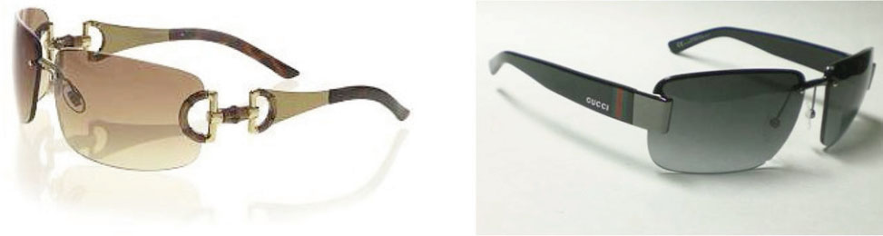
How Brand Loyal Consumers Deal with Counterfeiting
Flight
Reclamation
Abranding
Source: Young Jee Han, Joseph C. Nunes, and Xavier Drèze (2010), “Signaling Status with Luxury Goods: The Role of Brand Prominence,” Journal of Marketing 74 (July), 15–30, from Figures 2 and 3.
Notes:
How do people who buy luxury goods handle it when that brand is counterfeited? They may flight, reclaim, or abrand. Flight means they stop using the brand. Reclamation means they try to establish their long-term relationship with the real brand. Abrand means they minimize the visibility of their luxury goods so that only those who also have the real thing know that they also have the real thing.

Slide 29
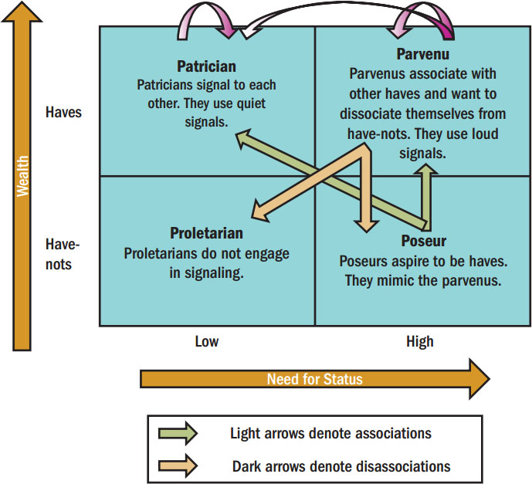
Status Signaling
Figure 12.3 A Typology of Status Signalling
Notes:
Consumers engage in conspicuous consumption as a way to display status markers, yet the prominence of these markers varies from products with large recognizable emblems to those with no logo at all. Those in the know can recognize a subtle status marker. In contrast, others may try to use loud signals to ensure others spot their status markers. These differences are labeled brand prominence. Consumers in this typology are assigned to one of four consumption groups based on their wealth and need for status. These are patricians, parvenus, poseurs, and proletarians.

Slide 30
For Reflection (3 of 3)
Provide examples of quiet versus loud brand signals used among your reference groups. What do these signals say about social class and lifestyle?
Notes:
Do you use quiet or loud signals or perhaps a mixture of both?

Slide 31
Chapter Summary
Both personal and social conditions influence how we spend our money.
We group consumers into social classes that say a lot about where they stand in society.
A person’s desire to make a statement about social class influences the products he likes and dislikes.
Lifestyle is the key to many marketing strategies.
Notes:
We’ve reviewed many concepts in this chapter. The key points are noted in the slide.

Slide 32

Copyright

